Slide 1
Angular JS
JAVASCRIPT FRAMEWORK
Ninganna C

Slide 2
Agenda
Session -1
Introduction
Module
Session -2
Digest Cycle
Session -3
Routing
Session -4
Events
Controller
Scopes
Directives
Data Binding
Filters
Shared Scope
Services
Validations
Select
Compile&Link
Watches
Application

Slide 3
Sl.No | Topic | Time | Sl.No | Topic | Time
01. | Angular Introduction | 10:30 – 11:00 | 14. | Routing | 10:30 – 11:20
02. | Angular Controllers | 11:00 – 11:20 | 15. | Routing Params | 11:20 – 11:40
03. | Angular Scope & Relation with Controllers | 11:20 – 11:30 | 16. | Resolving Routes | 11:40 – 12:00
04. | Scope Inheritance | 11:30 – 11:50 | 17. | Angular Services | 12:00 – 12:20
05. | Root Scope Inheritance | 11:50 – 12:10 | 18. | Compile & Link process | 12:20 – 01:15
06. | Data Binding | 12:10 – 12:30 | 19. | Modify DOM & Link | 02:00 – 02:30
07. | Directive & Custom Directives | 12:30 – 01:15 | 20. | Shared Scope | 02:30 – 02:50
08. | Filters | 02:00 – 02:30 | 21. | Angular Forms | 02:50 – 03:00
09. | Angular events | 02:30 – 02:50 | 22 | Angular Application | 03:00 – 05:00
10. | Angular validation | 02:50 – 03:30
11. | Angular Select | 03:30 – 04:00
12. | Watches | 04:00 – 04:30
13. | Digest Cycle Loop | 04:30 – 05:00

Slide 4
Prerequisites
Prerequisites.
HTML
JavaScript.
Installable.
Editor (atom / WebStorm …)

Slide 5
AngularJS
Angular JS is a client side JS framework.
Angular is developed by Google.
Built to ease the burden of writing complex apps.
Goals :
Separate DOM manipulation from application logic.
Separation of concern using MVC.
Make SPA development easier.
Provide solid foundation for robust JS client side application.
Extensibility and Customization.
Two way, One way & One time data binding.

Slide 6
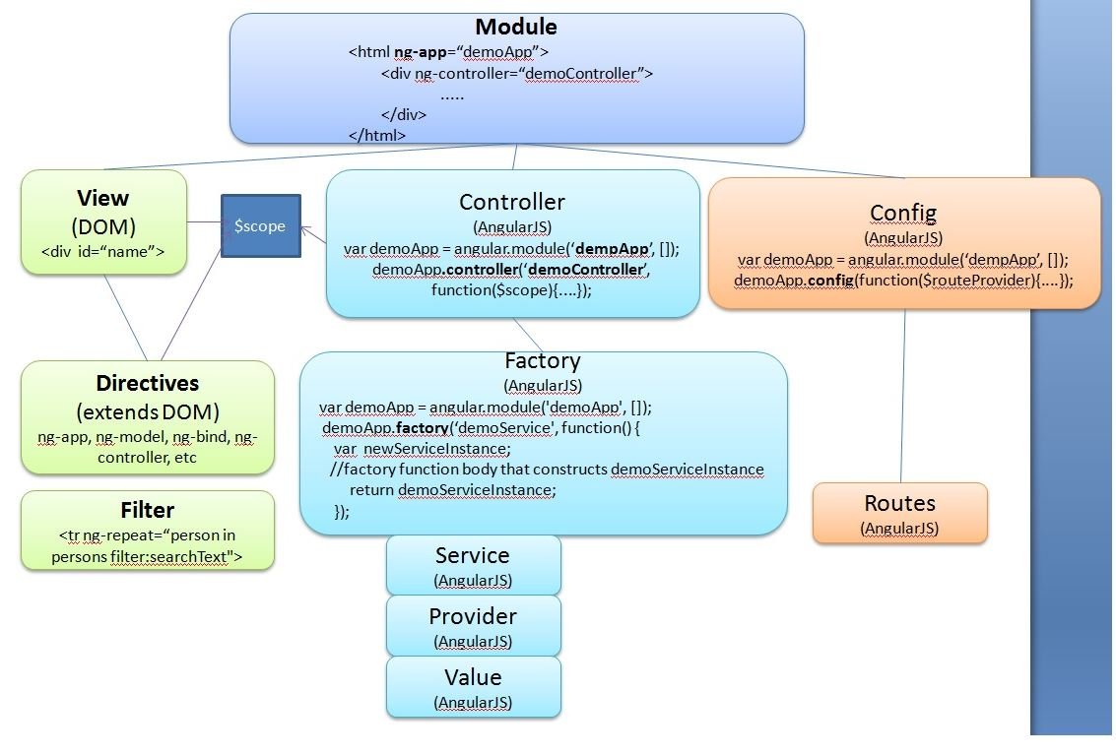
AngularJS Overview / features

Slide 7
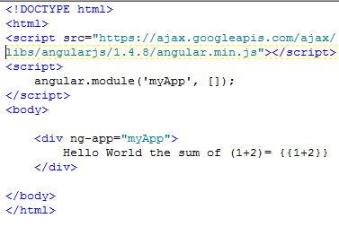
Steps to create Angular web page
Download or Refer the angular-version.js on web page.
Define an angular Module using “angular.module”.
Define an HTML element with “ng-app” and attach to the module.
Use an angular expression to test angular js.

Slide 8
Demo
01_introduction/01.html

Slide 9
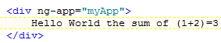
Angular Process
Angular.js is included and executed.
Angular module gets created (if added ).
Finds Template – HTML with angular markup.
“ng” attributes (directives).
Evaluating expressions.
Data binding markup.
Process template.
Compiles the template for errors.
Loads the template (instance) to memory.
Transform the template with data (evaluation expression / data binding).
Render to DOM tree (view).
Render

Slide 10
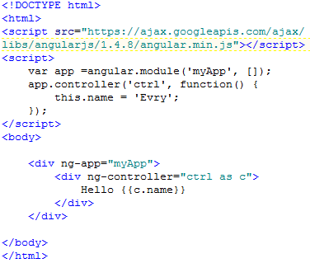
Angular Controllers
Controllers are JavaScript objects which contains application logic.
Usually defined as a part of angular module.
Allows us to send/receive data between DOM(View) and application logic.
Usually attached to a DOM element using ‘ng-controller’ directive.
Gets instantiated.
Exposes the data (Model) to be consumed by DOM (Views).
In other words MVC model

Slide 11
Complete Picture
Module
controller
Web service
…
Markup
View1
Database
…

Slide 12
Demo
02_controller/01.html

Slide 13
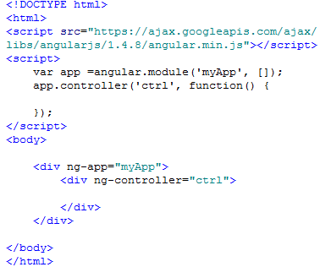
Angular Scope
Boundary /Context – memory area.
Can contain data – for data inding.
Sits at DOM – attahed to HTML element
Name:jhon
Sal:9000

Slide 14
Angular Scope
The scope is the binding part between the HTML (view) and the JavaScript (controller).
It is an JavaScript object with the available properties and methods.
When you make a controller in AngularJS, you pass the $scope object as an argument
Properties made in the controller, can be referred to in the view

Slide 15
Angular Scope Relation with Controller
Module
Name:jhon
Sal:9000
Controller
Scope gets merged into controller instance.
The controller has direct access to Scope.
DOM has direct access to Scope.

Slide 16
Demo
02_controller/02.html
02_controller/03.html
02_controller/04.html
02_controller/05.html
02_controller/06.html

Slide 17
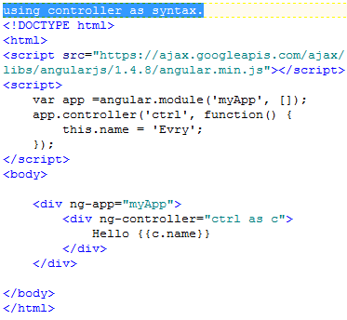
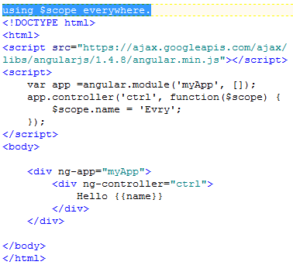
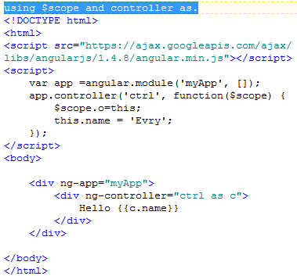
Scope different syntaxes

Slide 18
Demo
02_controller/07.html

Slide 19
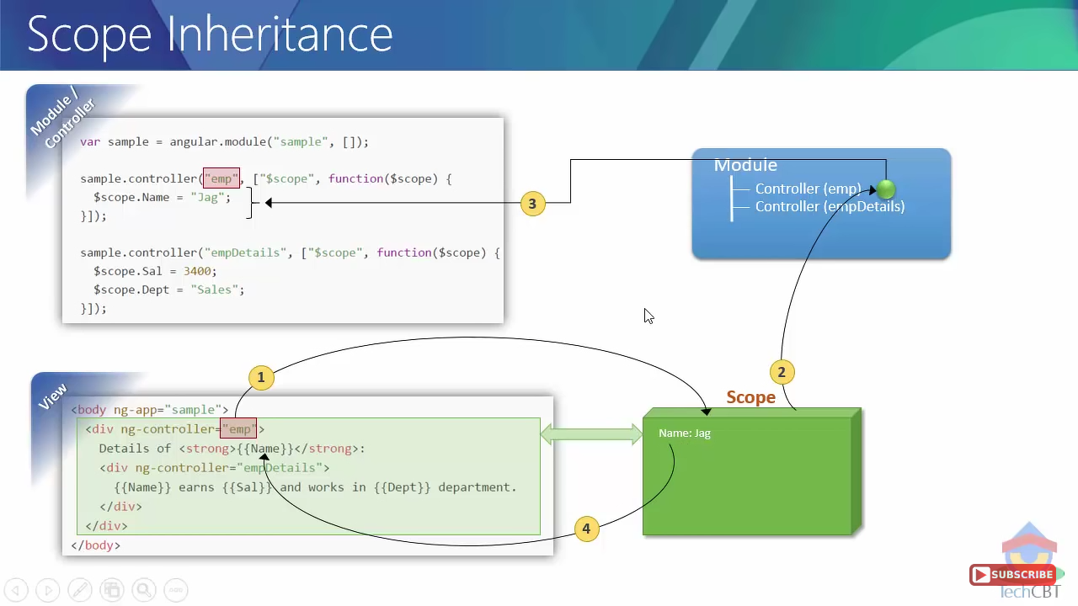
Scope Inheritance

Slide 20
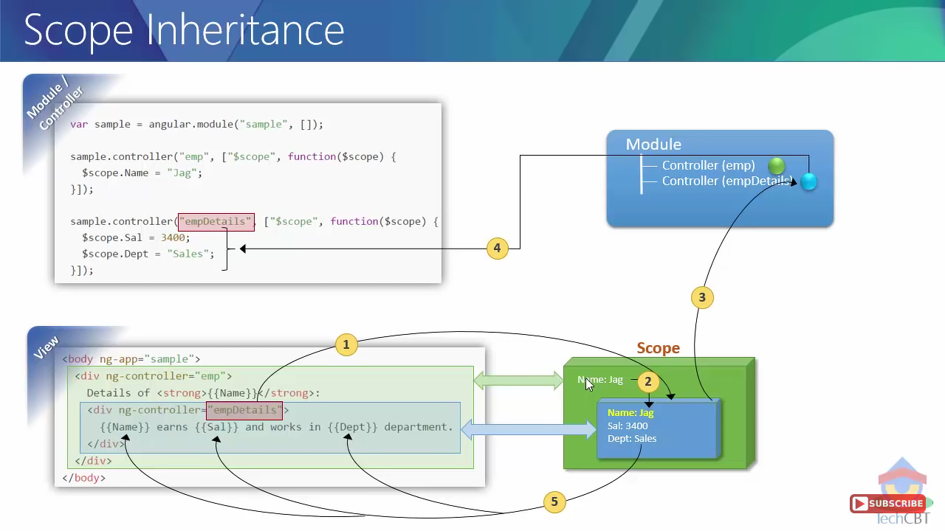
Scope Inheritance

Slide 21
Demo
03_scopeinheritance/01.html

Slide 22
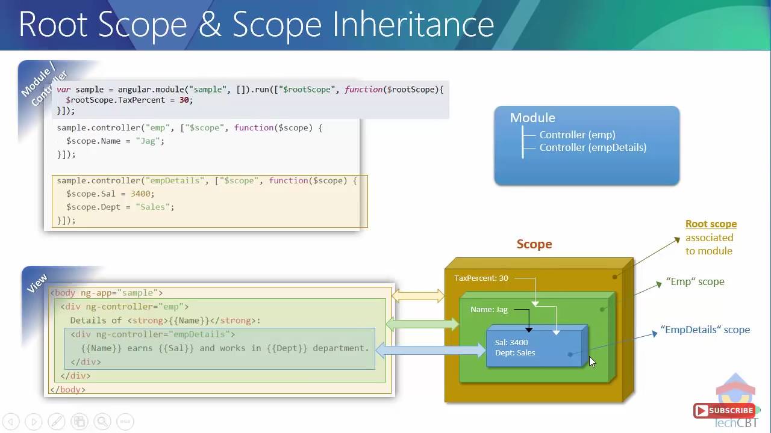
Root Scope

Slide 23
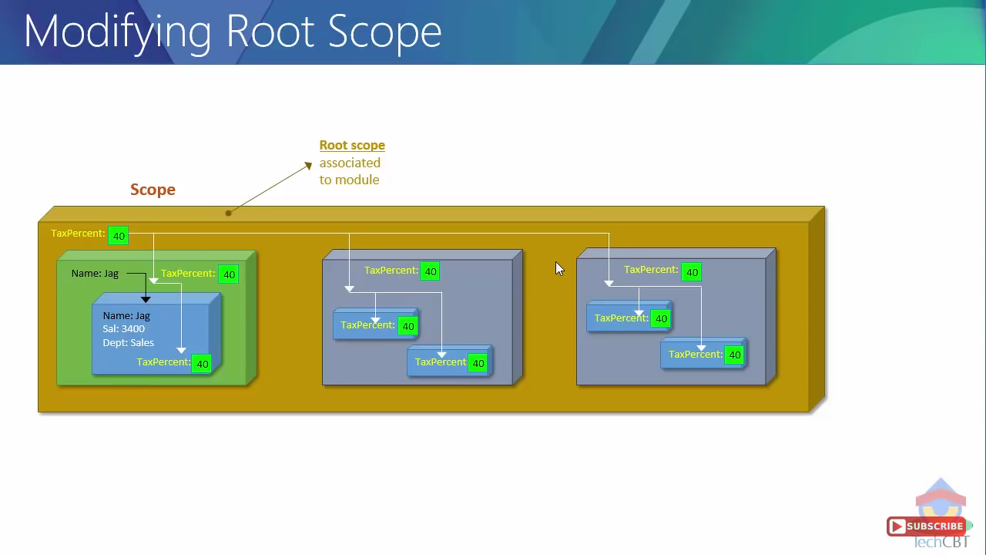
Modifying Root Scope

Slide 24
Demo
03_scopeinheritance/02.html

Slide 25
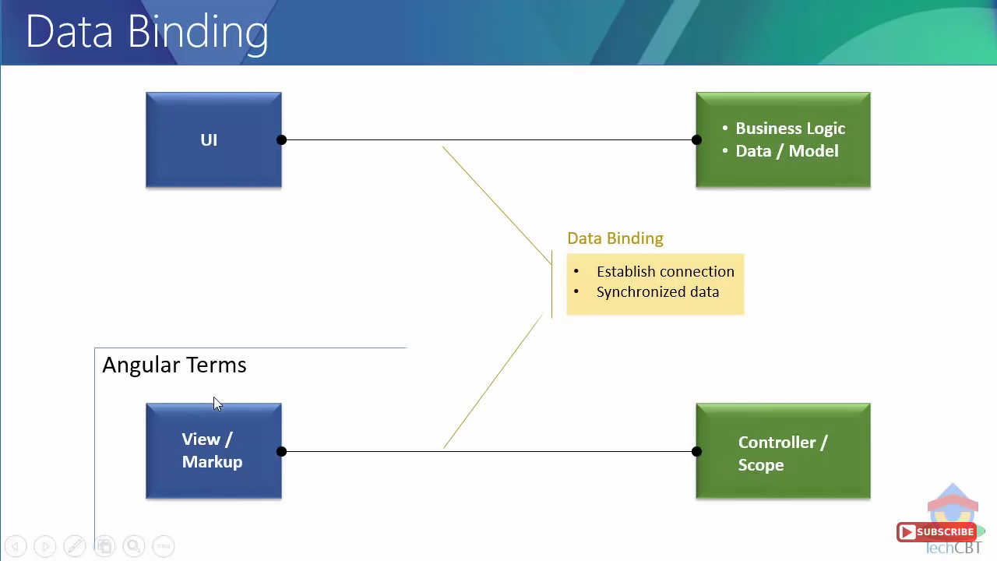
Data Binding

Slide 26
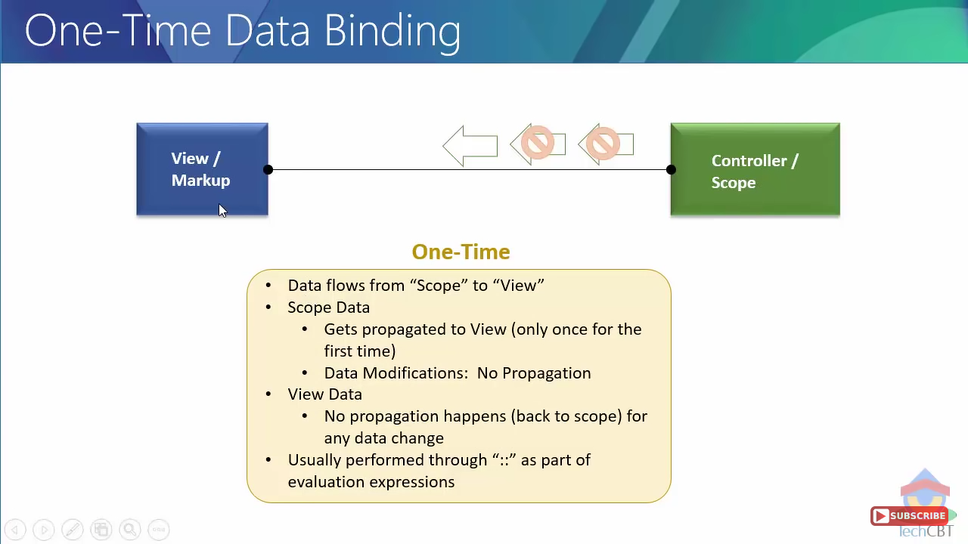
One Time Data Binding

Slide 27
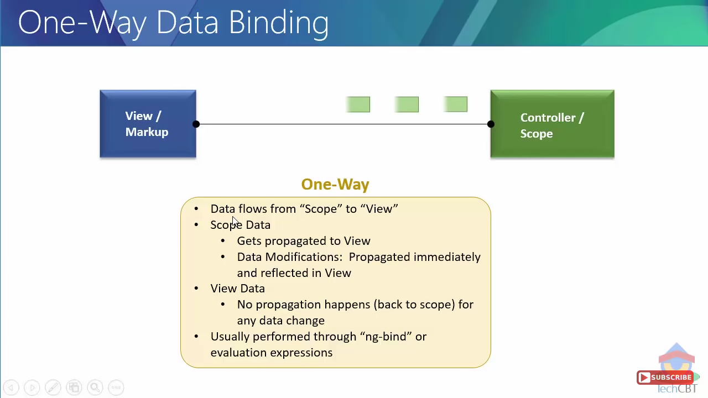
One Way Data Binding

Slide 28
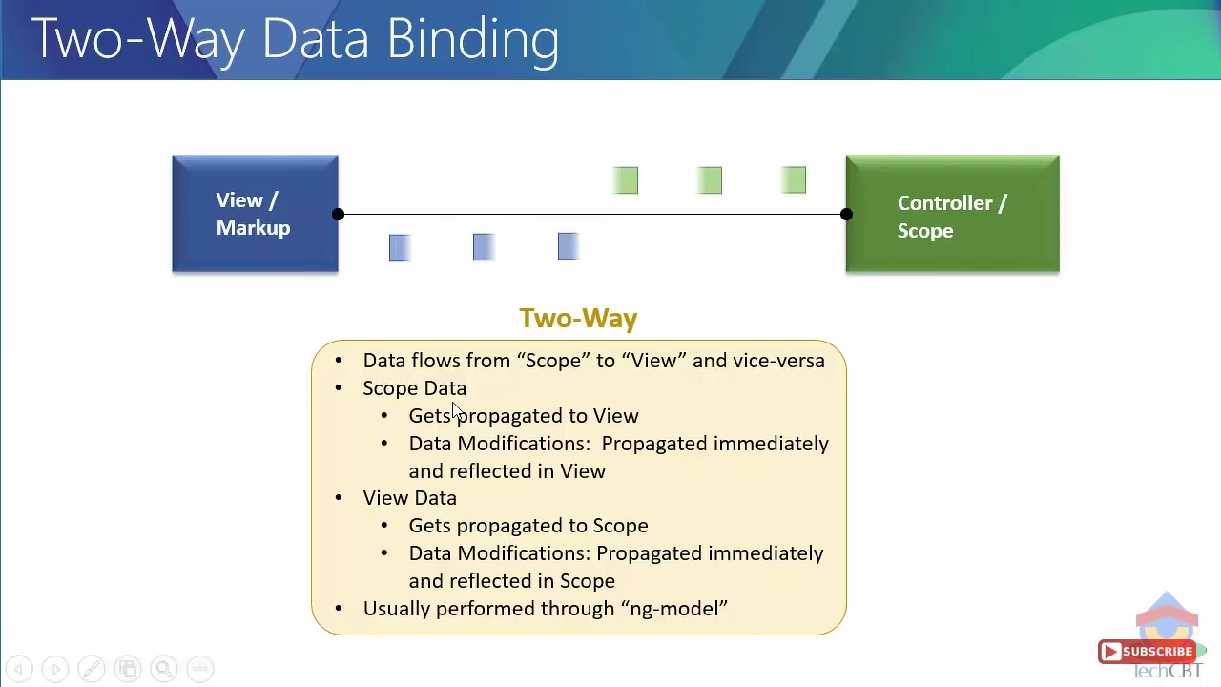
Two Way Data Binding

Slide 29
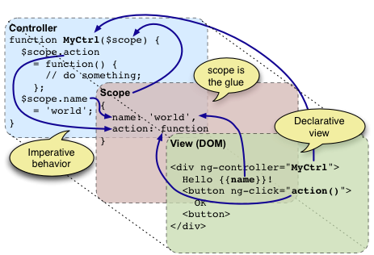
MVC

Slide 30
Demo
04_databinding/01.html
04_databinding/02.html

Slide 31
AngularJS Directives
Directives are markers (such as attributes, tags, and class names) that tell AngularJS to attach a given behavior to a DOM element
AngularJS directives are extended HTML attributes with prefix ng-.
ng-app directive initializes an AngularJS application.
ng-init directive initializes application data.
ng-model directive binds the value of HTML controls (input, select, textarea) to application data.

Slide 32
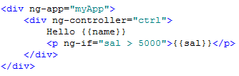
ng-if
Used to make a DOM element rendered or removed based on condition.
Completely removed from DOM (not show / hide using CSS).
Creates the scope for itself.
Evaluates the expression based on the scope.

Slide 33
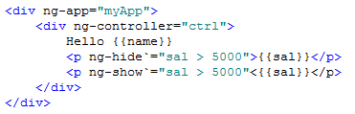
ng-show and ng-hide
Shows or Hides a DOM element based on a condition.
Not removed from DOM.
No Scope created for it self.
Evaluates expression based on the scope.

Slide 34
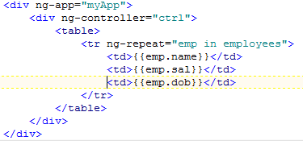
ng-repeat
Kind of a loop which iterates through all items in a collection.
Instantiates “ng-repeat” template (item) for every iteration
Bind the instantiated template (item) with the current object.
Creates the scope for each instantiated template.
Evaluates expression of template based on the current item scope.

Slide 35
Demo
05_directives/01.html
05_directives/02.html

Slide 36
Custom directives
Own angular directive.
Various Types.
Components
Custom element contains its own HTML template.
Decorators
To enhance functionality of existing directive.
Templating

Slide 37
Demo
05_directives/03.html
05_directives/04.html
05_directives/05.html
05_directives/06.html

Slide 38
Angular Js Filters
Any angular JS filter usually takes input and gives output.
Can be used to
Format data
Transform data
Search /Filter data
Can be used in
Templates
Controllers
Services
Types Of Filters.
Built-in
Custom

Slide 39
Angular Js Filters
currency Format a number to a currency format.
date Format a date to a specified format.
filter Select a subset of items from an array.
json Format an object to a JSON string.
limitTo Limits an array/string, into a specified number of elements/characters.
lowercase Format a string to lower case.
number Format a number to a string.
orderBy Orders an array by an expression.
uppercase Format a string to upper case.

Slide 40
Demo
07_filters/01.html
07_filters/02.html
07_filters/03.html
07_filters/04.html

Slide 41
Angular Js Events
You can add AngularJS event listeners to HTML elements by using one or more of these directives.
ng-blur | ng-keypress
ng-change | ng-keyup
ng-click | ng-mousedown
ng-copy | ng-mouseenter
ng-cut | ng-mouseleave
ng-dblclick | ng-mousemove
ng-focus | ng-mouseover
ng-keydown | ng-mouseup

Slide 42
Demo
08_events/01.html

Slide 43
Angular Js Validation
AngularJS offers client-side form validation.
AngularJS monitors the state of the form and input fields (input, textarea, select), and lets you notify the user about the current state.
AngularJS also holds information about whether they have been touched, or modified, or not.
You can use standard HTML5 attributes to validate input, or you can make your own validation functions.

Slide 44
Demo
09_validation/01.html
09_validation/02.html

Slide 45
Angular Js Select
Dropdowns made with ng-options allows the selected value to be an object,
While dropdowns made from ng-repeat has to be a string.
<select ng-model="selectedName" ng-options="x for x in names"></select>
<select><option ng-repeat="x in names">{{x}}</option></select>

Slide 46
Demo
10_select/01.html
10_select/02.html
10_select/03.html

Slide 47
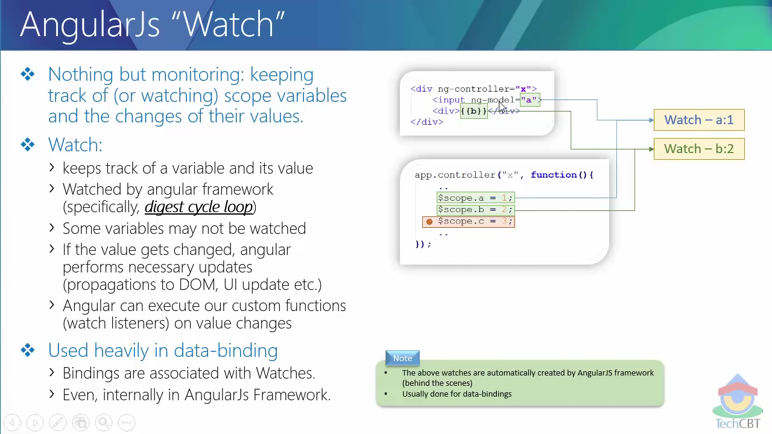
watchers
Nothing but monitoring : keeping track of (watching) scope variables and change of their values.
How watch works:
When ever there is a databinding to a scope variables it creates watch.
Watched by angular js framework (specifically digest cycle).
Some variables may not be watched.
Can execute custom functions on value change.
Used heavily in data binding
Bindings are associated with watches

Slide 48
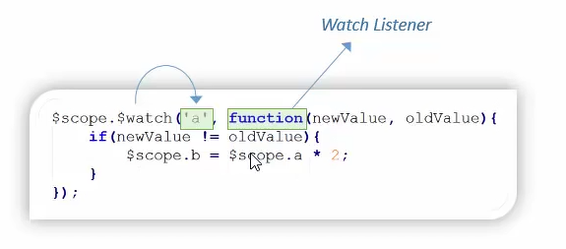
Watch and Listener
We can add our own watch using $watch function available through $scope object.
Used when angular js does not consider the variables for watching.
Watch Listener is a function which gets executed when a watch detects value change.

Slide 49
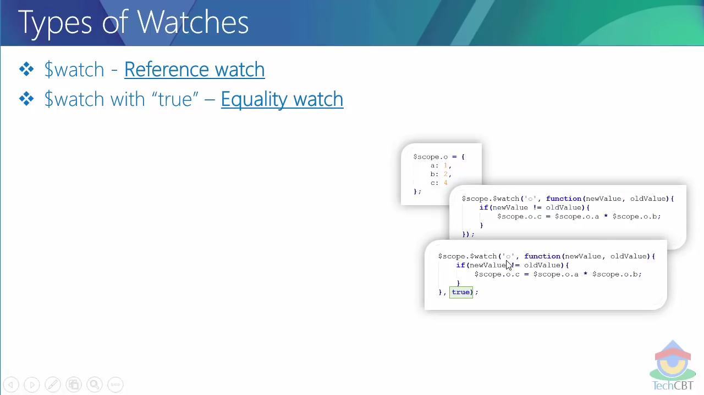
Types of Watches
$watch – Reference watch.
$watch with true – Equality watch.
$watchGroup – Reference watch for multiple variables, doe not support true(deep watch).
$watchCollection – used to watch arrays, detects the modification to arrays, not supported to array items change.

Slide 50
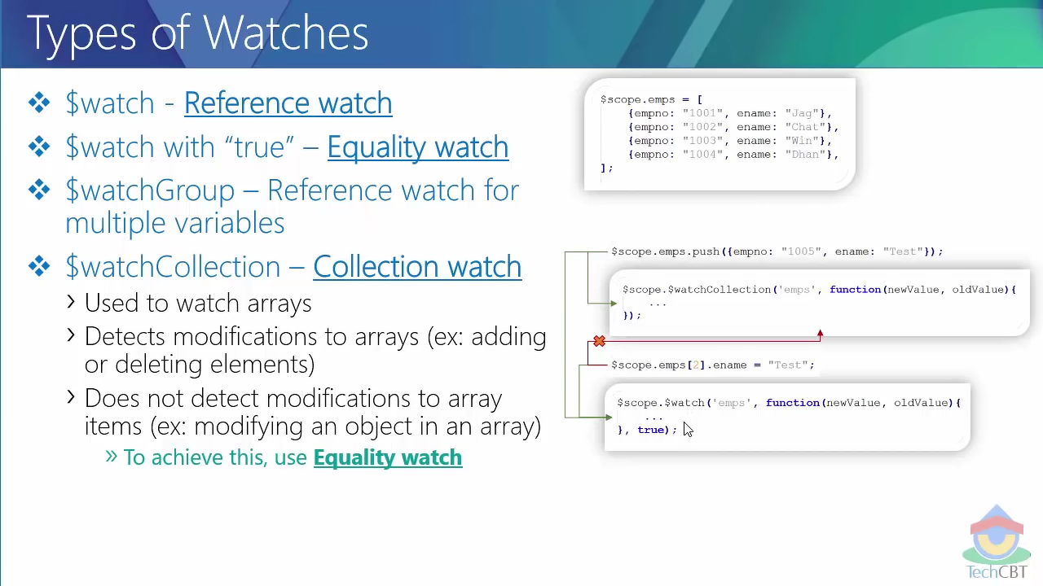
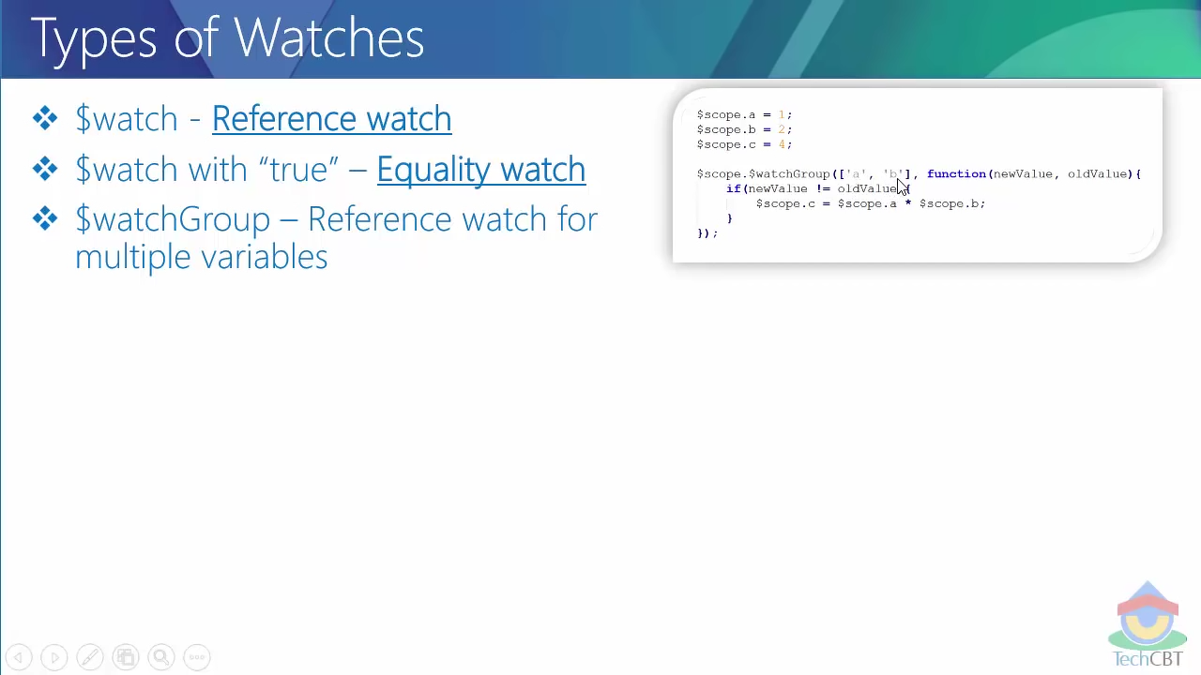
$watchGroup & $watchCollection

Slide 51
Demo
12_watches/01.html
12_watches/02.html
12_watches/03.html
12_watches/04.html
12_watches/05.html
12_watches/06.html

Slide 52
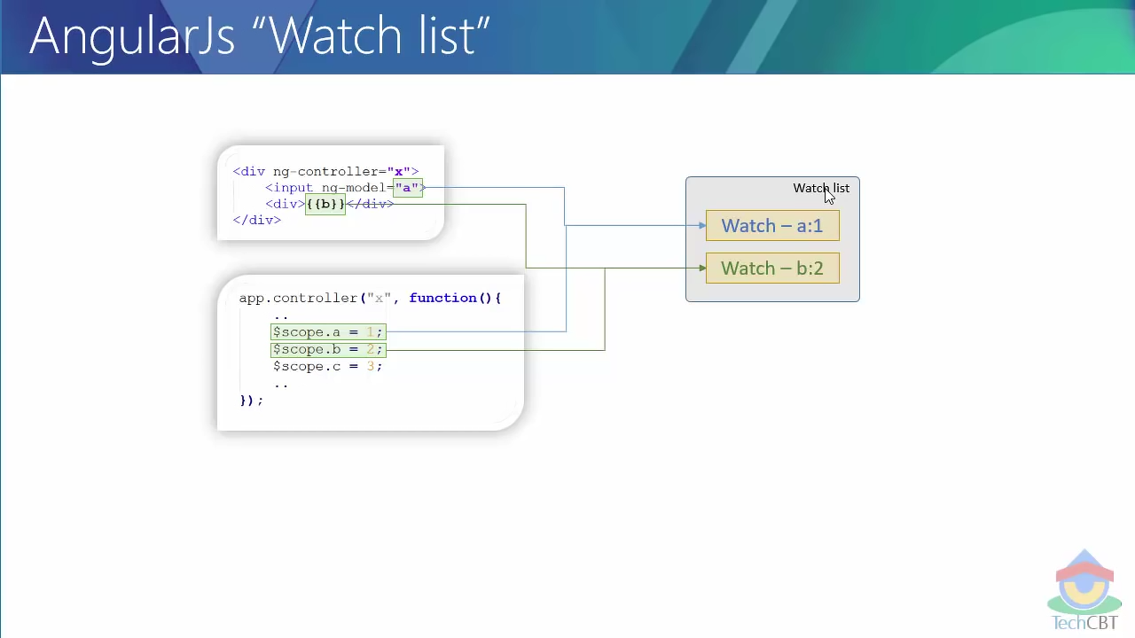
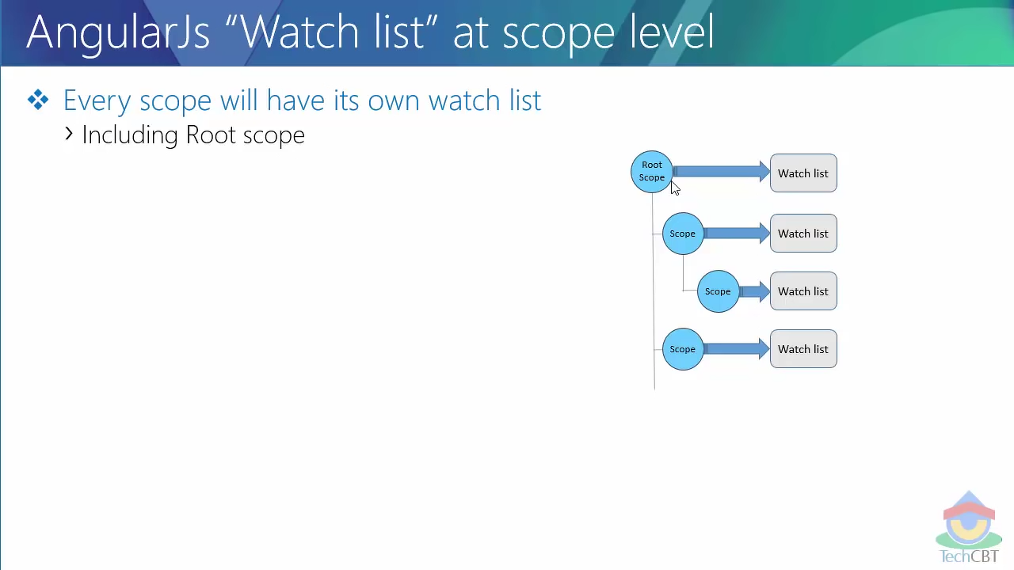
Watch List

Slide 53
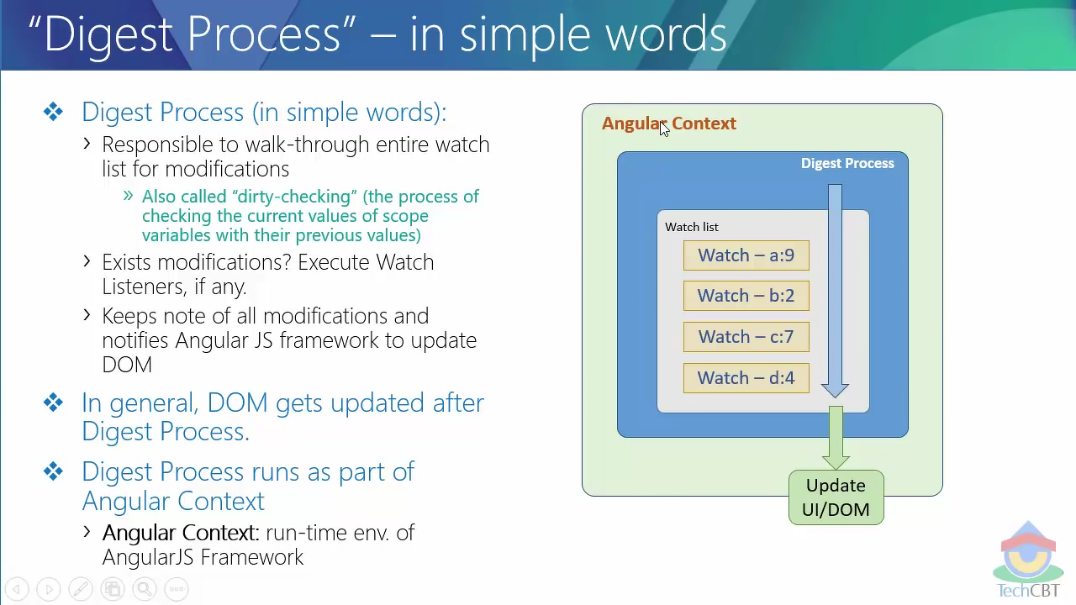
Digest Process
Responsible to walk through entire watch list for modification. Also called dirty checking.
Exists modification? Execute the watch listners if any.
Keeps note of all modifications and notifies angular framework to update the DOM.
DOM get update after Digest process.
Digest process runs as a part of angular context.

Slide 54
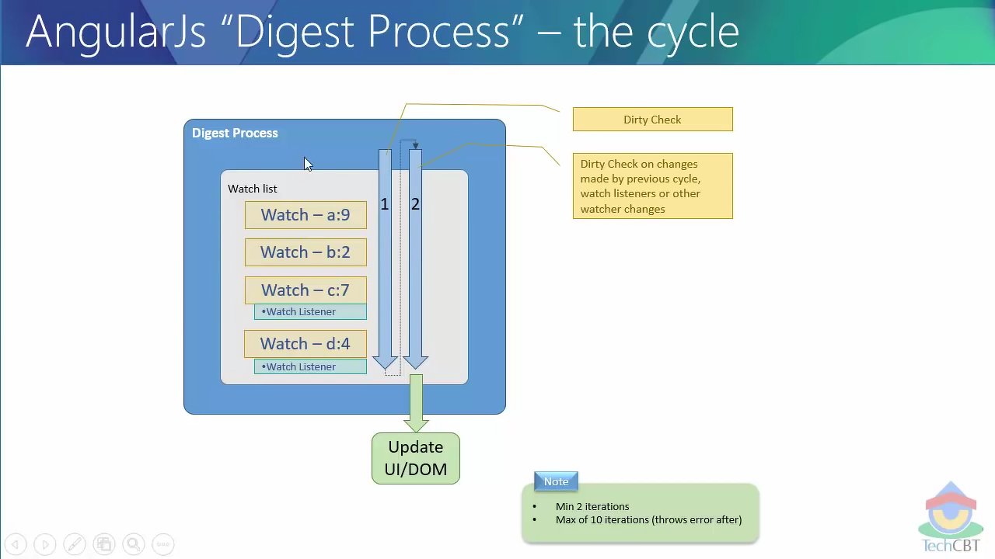
Digest Cycle

Slide 55
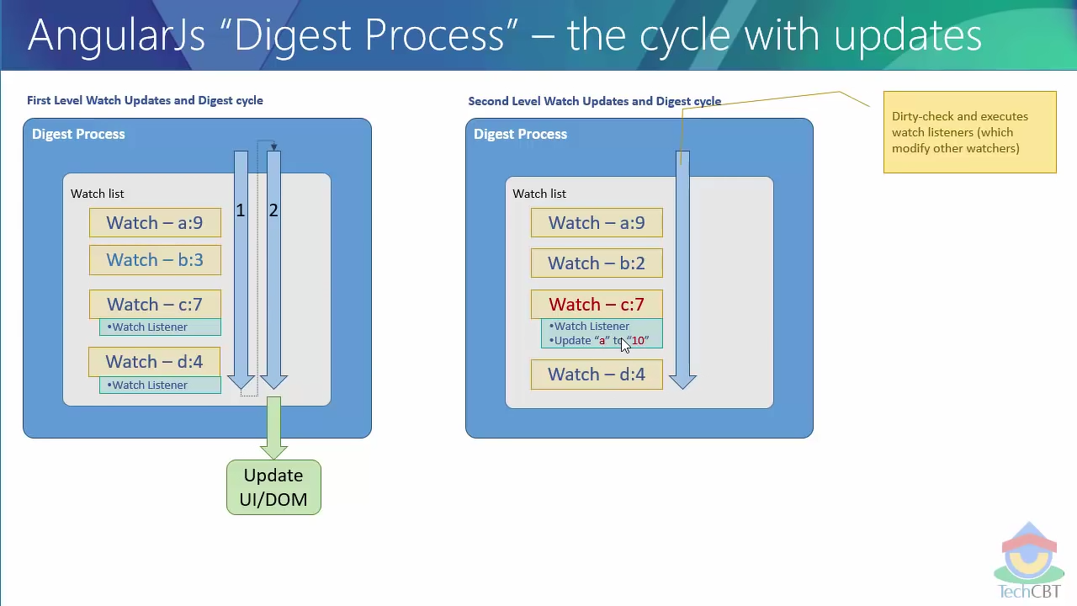
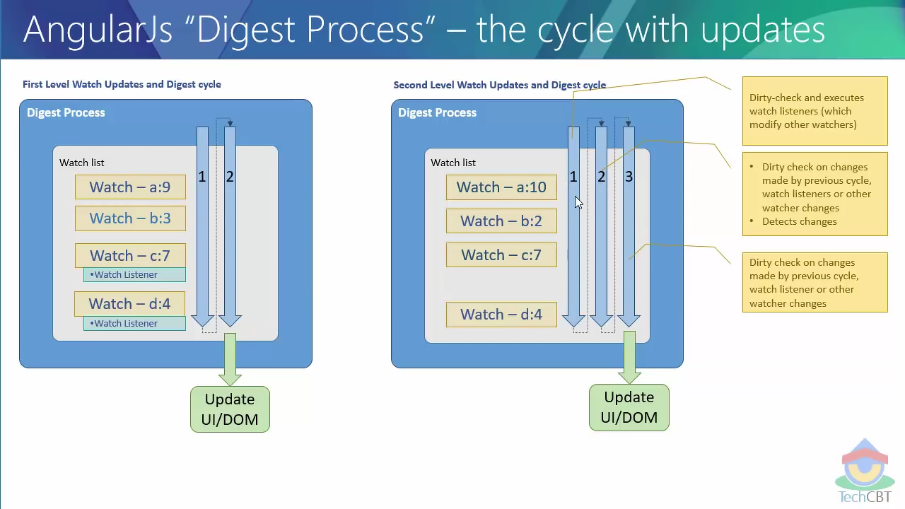

Slide 56
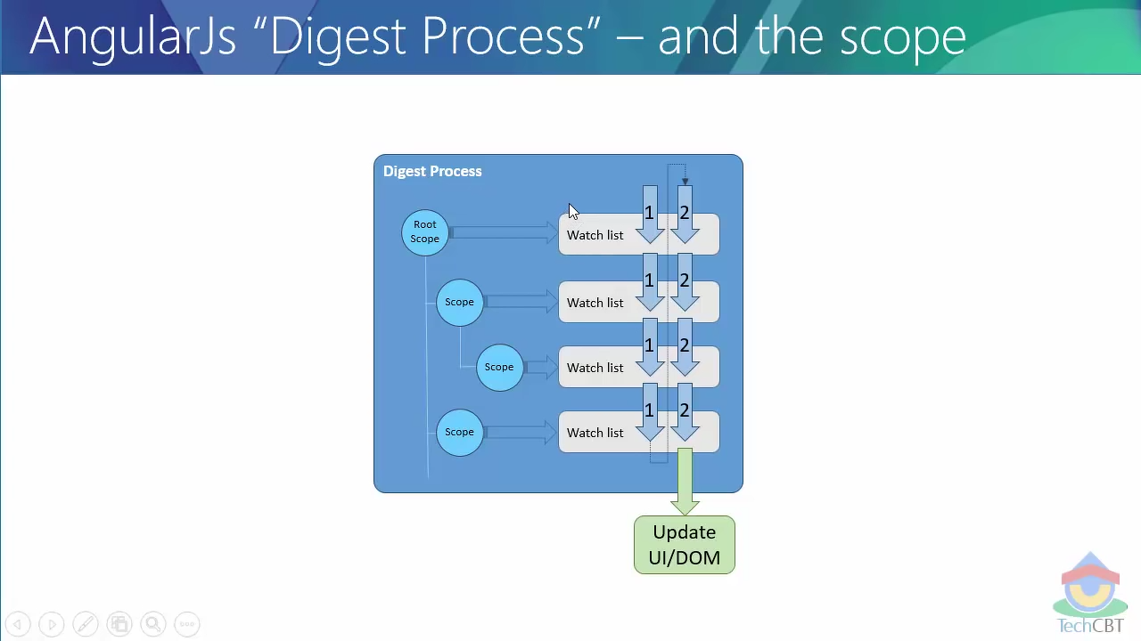
Digest Cycle Scope level

Slide 57
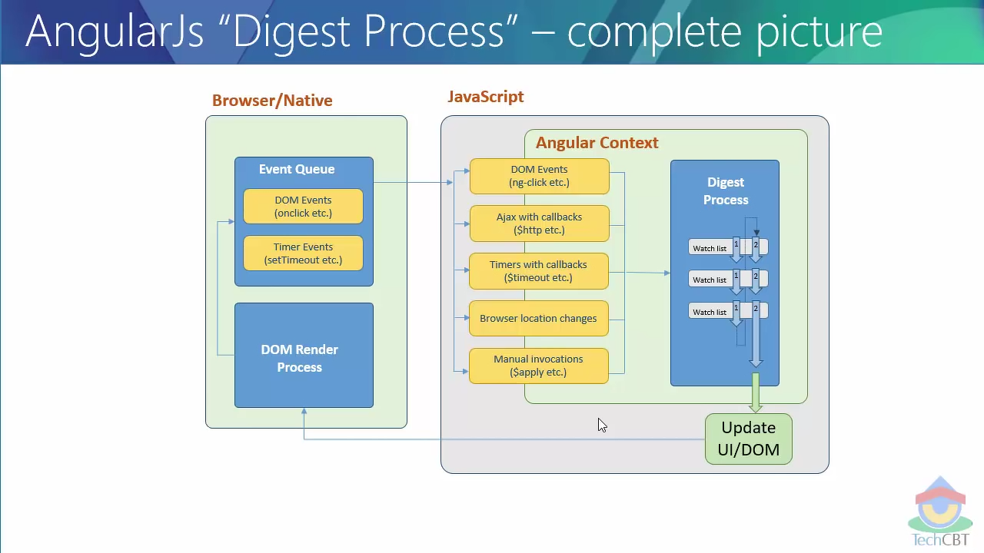
Complete Picture

Slide 58
Demo
13_digest/01.html
13_digest/02.html

Slide 59
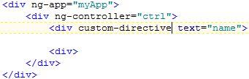
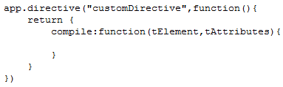
Compile
The first step of execution / processing a directive for rendering.
Loads and Traverse the DOM.
Compile each of the directives collected (nested Directive)
Happens for both existing and custom directive.
“compile” function : executes code during compilation.

Slide 60
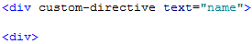
Link
The next phase after compile.
Works on an instance of a template.
3 internal phases of an template (executed in sequence).
Controller
Pre-Link
Post-Link
Gets rendered after link phase.
instance

Slide 61
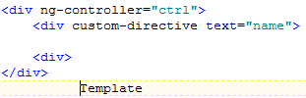
Compile & Link : The Process
Compile
1.Controller
2.Pre
3.Post
4.Render
instance
Compile:
Loads & Traverse the DOM
Execute only one
Return link function
No scope present
No instance template created yet
Can manipulate DOM
Can not play with data / events
Controller:
The first to execute for every instance of template
Creates the scope for the template instance.
Cn manipulate data for template instance
Not recommended to access DOM
Pre link:
Executes immediately after controller phase
Ref DOM template instance is available
Template instance not linked to scope
No access to child elements
Post Link:
Last phase (linking function).
Scope & template Instance linked
Child elements are ready.
Safe to attach event handlers
Scope can be manipulated but not safe for childrens

Slide 62
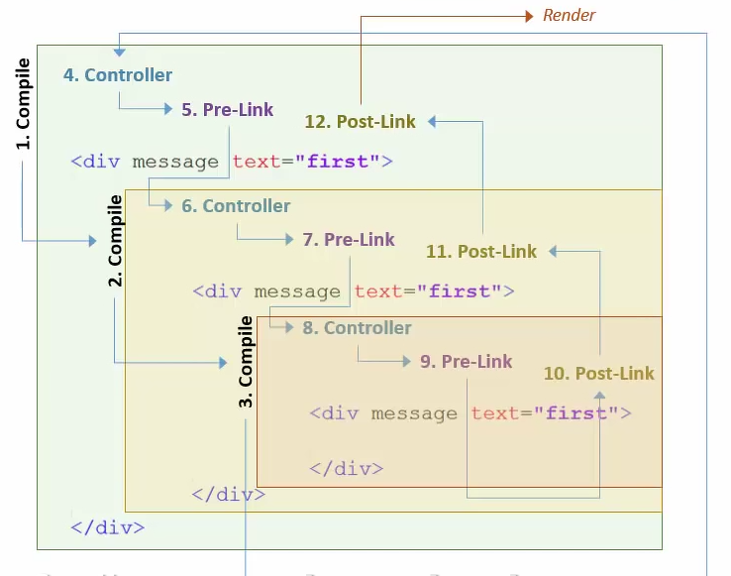
Compile & Link: Nested Directive

Slide 63
Demo
06_compile&link/01.html
06_compile&link/02.html
06_compile&link/03.html
06_compile&link/04.html
06_compile&link/05.html
06_compile&link/06.html
06_compile&link/07.html
06_compile&link/08.html
06_compile&link/09.html

Slide 64
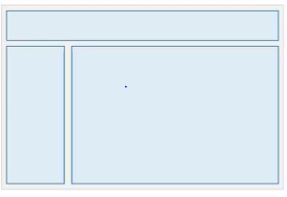
What is Routing
Does three things in general
Goes to location (hashed url).
Gets new content (view/html).
Injects into current page (HTML/DOM).
Mainly used in SPA’s
Various parts of views – Logical division of app.
Loading the views independently/individually
Routing : Available at server/client.

Slide 65
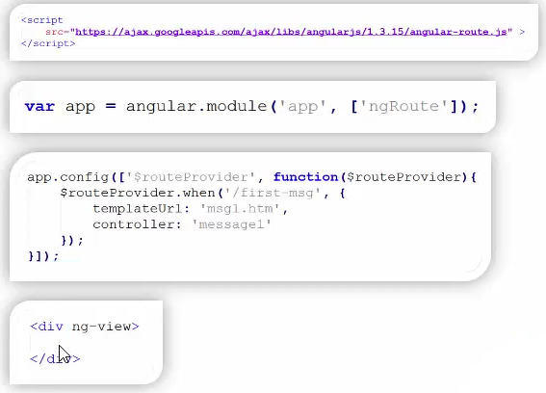
Routing in Angular Js
Client side Routing.
Several ways to achive – ngRoute, UIRouter etc…
Steps for (ngRoute).
Include ngRoute module – angular-route.js.
Use ngRoute as module dependency.
Use $routeProvider to configure the roots.
Routing urls (Location).
Content (View).
Controllers to be associated with the view.
Declare “ng-view” to hold (inject) content (view).

Slide 66
Demo
13_routing/01.html
13_routing/02.html
13_routing/03.html
13_routing/04.html
13_routing/ngparam01.html
13_routing/ngparam02.html
13_routing/ngparam03.html
13_routing/ngparam03.html

Slide 67
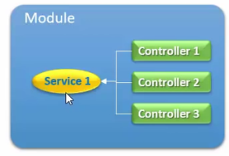
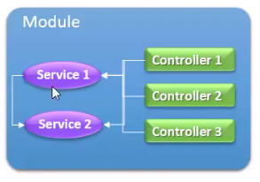
Angular Services
Services is a special unit of code which can be used across different controllers.
Services can be Utilities or Business Logic Units.
Service is a singleton.
Instantiated only once.
Same instance is maintained throughout the lifetime of the application.
Unlike services, Controllers are created as they are needed and destroyed if they are not in use.
Services are loaded and Instantiated lazily.
Only when controller (referring the respective service) is instantiated

Slide 68
Service Types
Built In Services
Part of angular framework.
Ex: $http, $log, $location.
Custom services.
Developed by us
Could be extensions to built in services.
Could be business services.

Slide 69
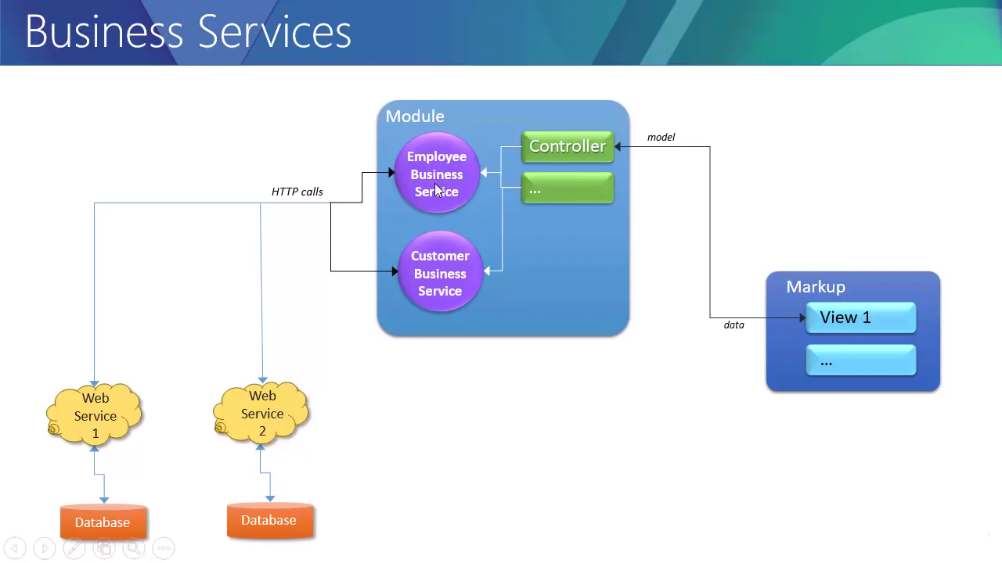
Business Services

Slide 70
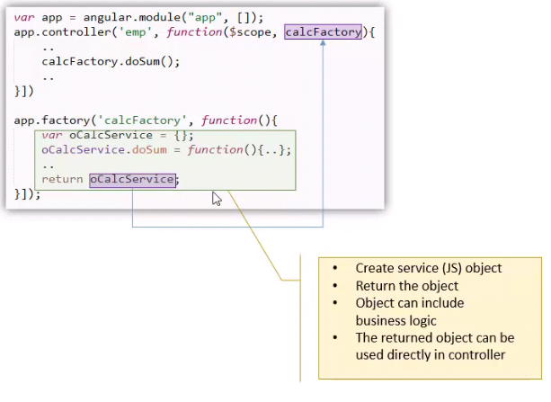
Custom Services - Factory

Slide 71
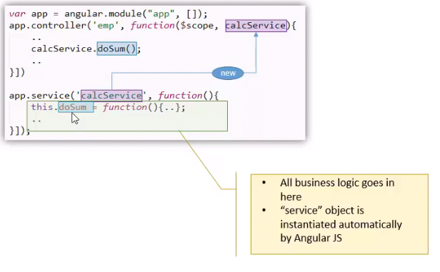
Custom Services - Service

Slide 72
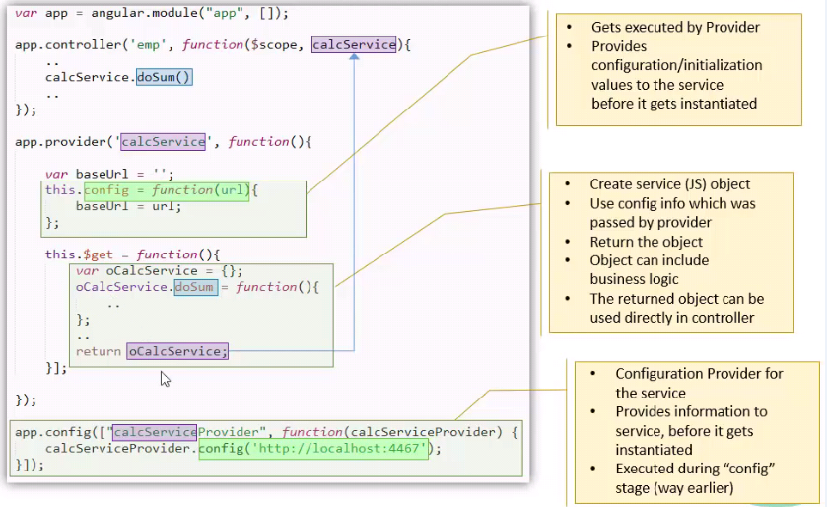
Custom Services - Provider

Slide 73
Demo
Develop an simple Application which includes all the features of angular js

Slide 74
Multiple Views | Transclusion
UI Router | Transclusion Scope
UI Router Params | Isolated Scope
UI Router Resolve | Watchers
$state service | $apply v/s $digest
Nested State & Views | $eval v/s $parse v/ $interpolate
$broadcast, $emit, $on | Inherited / child Scope
Clone linking function | $route service

